Slide 1
TRAVEL OPTIMIZATION
PRIYA (191046025)
WAJOUD (191046031

Slide 2
WHAT IS OPTIMIZATION?
Optimization is an important tool in making decisions and in analysing physical systems. In mathematical terms, an optimization problem is the problem of finding the best solution from among the set of all feasible solutions.
Optimization is used in machine learning during model training, when we are trying to minimize the cost of errors between our model and our data points.

Slide 3
Travel optimization
Planning routes is a very visual process. Being able to see exactly where each stop is.
Process of finding the most cost-effective route for a set of stops.
These routes should give you the shortest drive time.
Since it reduces the time spent traveling and at the same time reduces the incurred cost in the process.

Slide 4
ARCHITECTURE
ANALYZING AND TAKING TEST LOCATIONS
GENERATING POSSIBLE ROUTES
FINDING OPTIMAL ROUTE

Slide 5
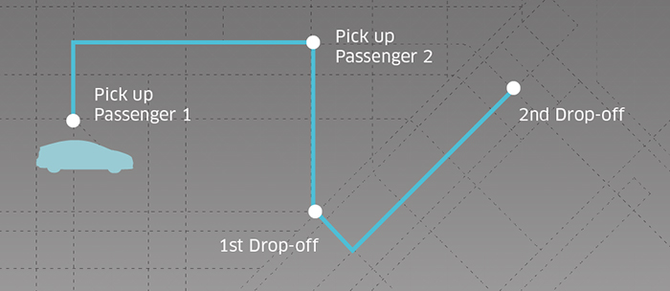
We can use the power of machine learning to forecast travel times between each two locations and use the genetic algorithm to find the best travel itinerary.

Slide 6
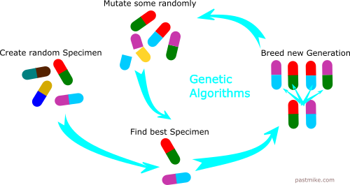
GENETIC ALGORITHM
In the genetic algorithm a population of candidate solutions to an optimization problem is evolved toward better solutions, and each candidate solution has a set of properties which can be mutated and altered.

Slide 7
GA
The process of natural selection starts with the selection of fittest individuals from a population.
They produce offspring which inherit the characteristics of the parents and will be added to the next generation.
If parents have better fitness, their offspring will be better than parents and have a better chance at surviving.
This process keeps on iterating and at the end, a generation with the fittest individuals will be found.

Slide 8
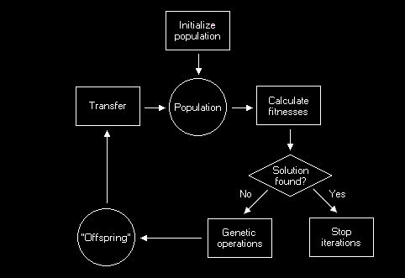
GA FLOWCHART

Slide 9
Five phases are considered in a genetic algorithm.
Initial population
Fitness function
Selection
Crossover
Mutation

Slide 10

The selection chooses the fittest individuals. You will need a method to calculate this fitness. Let's use the space optimization example. The fitness method simply calculates the amount of free space each individual/solution offers. The best are selected for further iteration.
The cross-over is the method for combining those selected individuals into new individuals. Remember that the individuals are simply strings of values. The cross-over splits up the "parent" individuals and recombines them. Here's an example of how two "parents" cross over to make two "children":

Slide 11
The mutation simply adds some noise to "genes" of the individuals (usually the "children"). It is a way of varying the "gene pool" to provide some protection against "in-breeding."

Slide 12
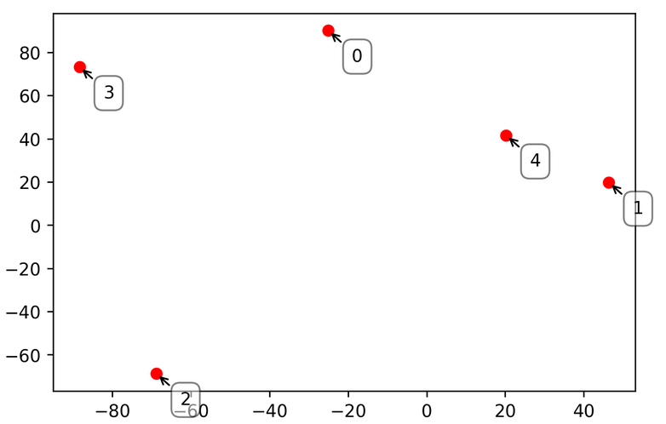
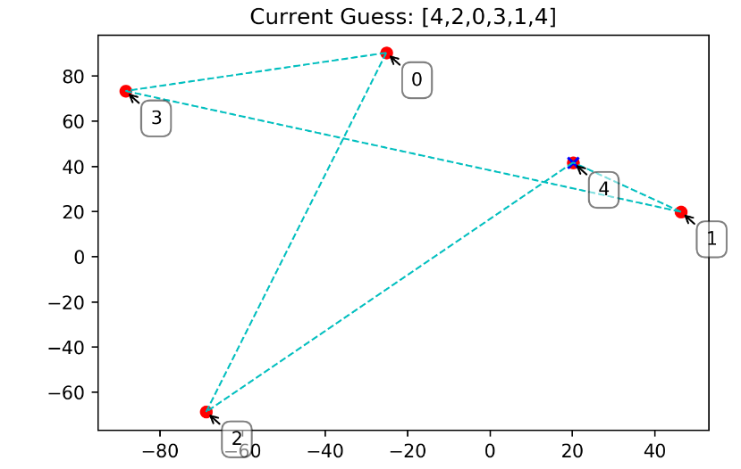
INPUTS

Slide 13
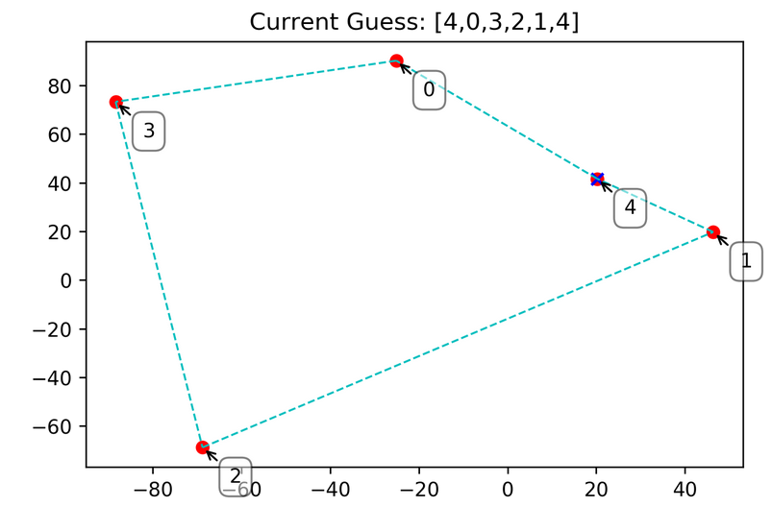
OPTIMIZED OUTPUT

Slide 14
FUTURE WORK
To find the minimum travel time.

Slide 15
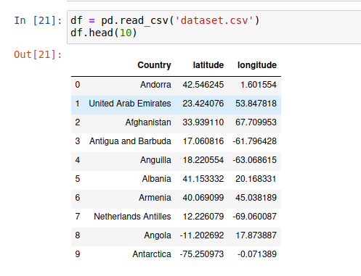
Data set
Data set contains different country location
The location are consist of latitude and longitudes
We use this data set to find the optimal route to travel form a particular location

Slide 16
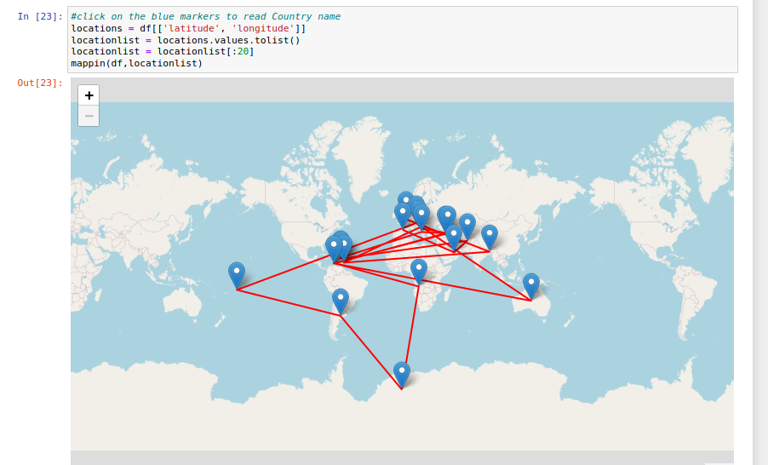
Input from the data set

Slide 17
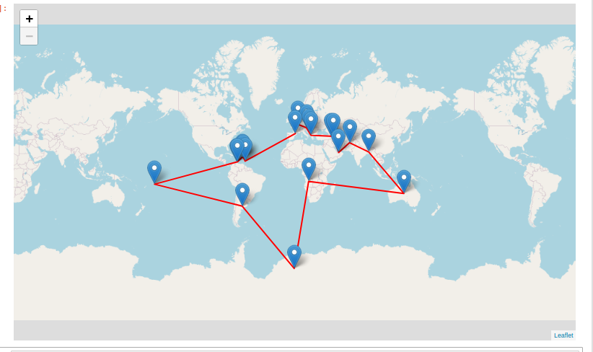
Output (optimizes Route )

Slide 18
THANK YOU

